Slide 1
Chapter Fifteen
Working with Windows 8/8.1

Slide 2


220-902 Objectives Covered
1.1 Compare and contrast various features and requirements of Microsoft Operating Systems (Windows 8, Windows 8.1).
1.2 Given a scenario, install Windows PC operating systems using appropriate methods.

Slide 3
Four Windows 8 Editions
Windows 8 (commonly called “core”)
Windows 8 Pro (similar to Windows 7 Professional and Windows 7 Ultimate in terms of features)
Windows 8 Enterprise (for volume licensing)
Windows 8 RT (for preinstallation on tablets). Includes touch-optimized versions of Microsoft Office.
All of the versions include the Start screen, Desktop, Windows Store, secure boot, and drive encryption.
Only the Pro and Enterprise versions support BitLocker and Encrypting File System (EFS).
Notes:
Windows 8.1 was released as an update to replace Windows 8 and to make running the
operating system on a system without a touchscreen easier – minimal differences.
Windows 8 RT runs on an ARM (Advanced RISC Machine) processor, not
on x86/x64 processors. This is important because programs and upgrades
written for the x86/x64 processors will not work on RT

Slide 4
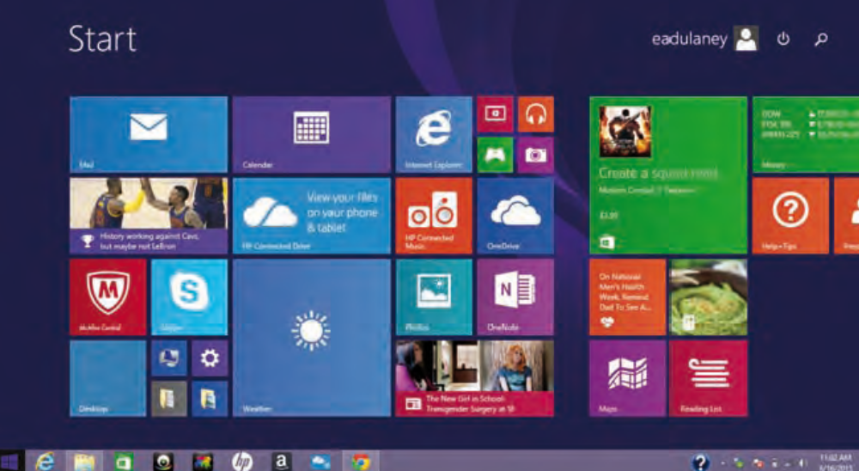
Windows 8 User Interface (UI)
Notes:
When the new interface was released with Windows 8, it was called the
Metro UI. This name did not last long; it came to be known as the new Windows
UI or the Windows 8 UI.

Slide 5
Features
MetroUI (Now Windows UI)
Pinning
OneDrive
Windows Store (for apps)
Multi-monitor Taskbar
Charms
Start Screen (Tiled look)
PowerShell (.NET Scripting)
Live Sign-in (single sign-on)
Action center
Notes:
Supports Pinning favorite apps to the start screen
Multi-monitor taskbar - Taskbar appear in each monitor
Charms - These are controls that are available on the side of the screen for every Windows Store app. They consist of Search, Share, Start, Devices, and Settings
Live Sign-on - it is possible to use your Microsoft account (MSN, Hotmail, Outlook, and so forth) username and password to log in to your Windows 8–based PC, In a non-domain-based environment
Action Center - a central dialog for dealing with problems, security, and maintenance. Control Panel ➢ System and Security ➢ Action Center

Slide 6
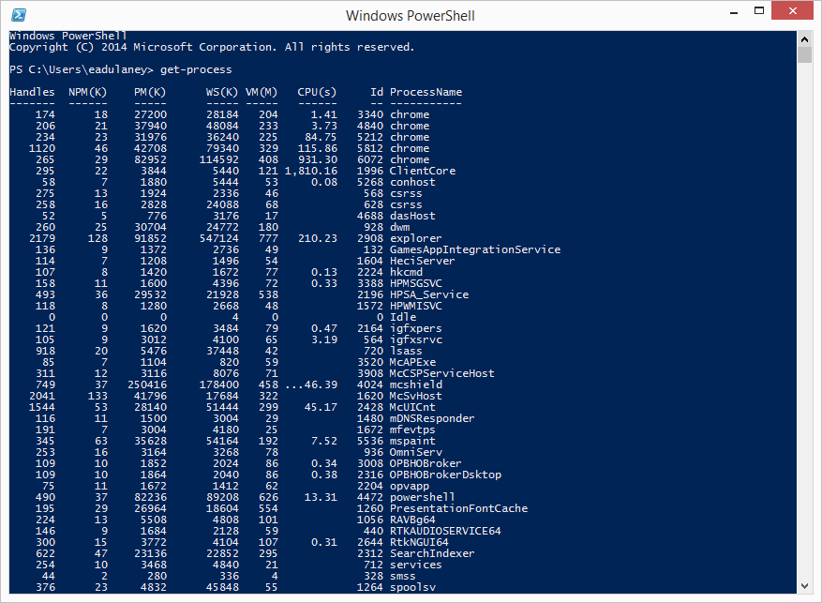
Windows PowerShell
Notes:
A greatly enhanced command interface where you can write script files based on the .NET programming framework

Slide 7
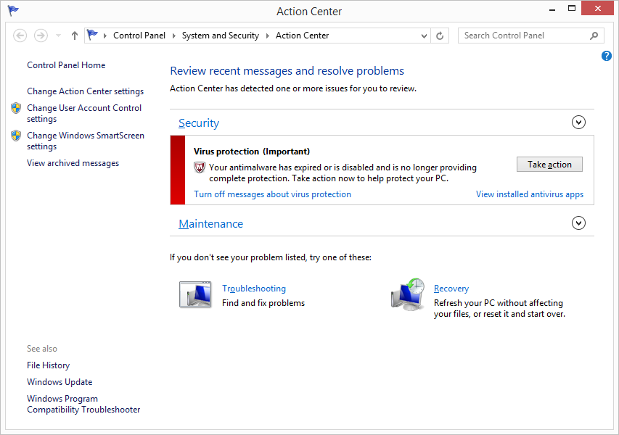
Action Center

Slide 8
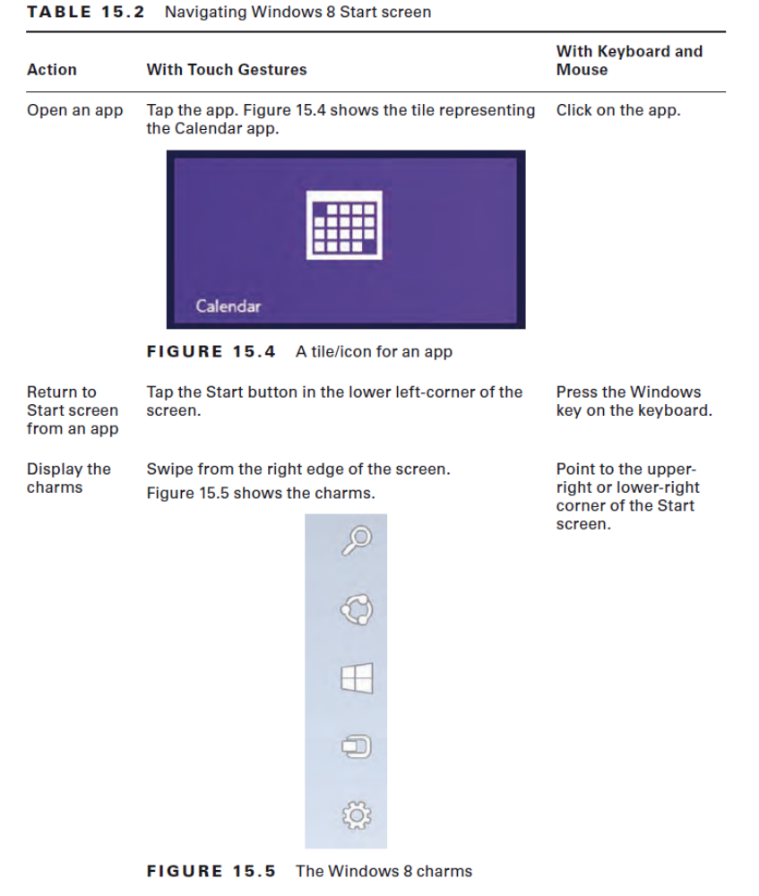

Slide 9
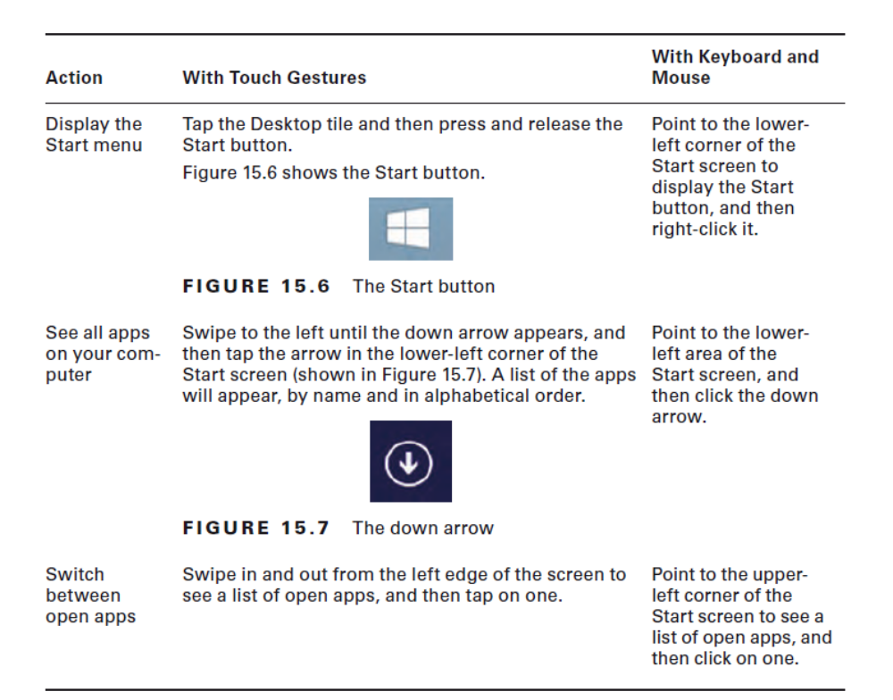

Slide 10
Upgrade Options
Existing Operating System | Windows 8 Core | Windows 8 Pro | Windows 8 Enterprise
Windows 7 Starter | Yes | Yes | No
Windows 7 Home Basic | Yes | Yes | No
Windows 7 Home Premium | Yes | Yes | No
Windows 7 Professional | No | Yes | Yes
Windows 7 Ultimate | No | Yes | No
Windows 7 Enterprise | No | No | Yes
Notes:
2 methods used to install Windows:
1. Clean – no traces of previous OS left. When formatting is involved, it is a clean install
2. Upgrade – traces from old OS left such as user accounts, data or apps
Since Windows RT 8 is designed for pre-installation on tablets, there is not an upgrade
path for it

Slide 11
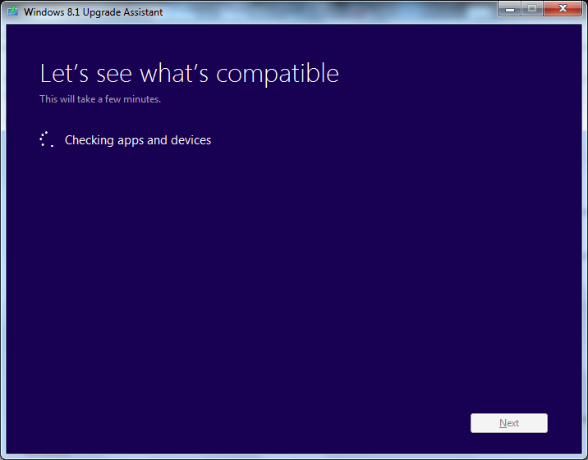
Upgrade Assistant
Notes:
The easiest way to see if your current hardware can run Windows 8.1 is to download
and run the Windows 8.1 Upgrade Assistant

Slide 12
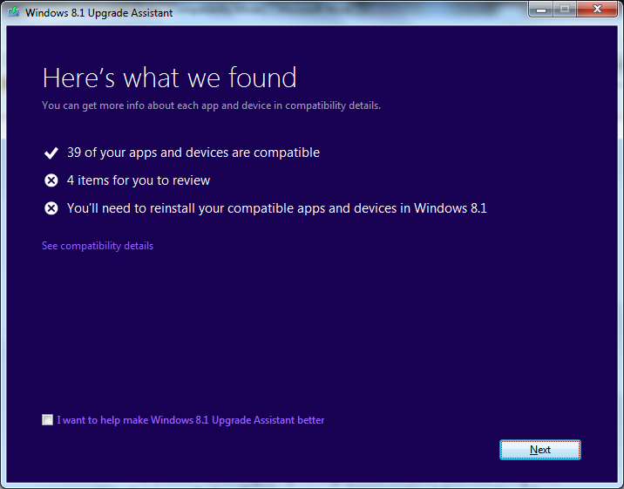

Slide 13
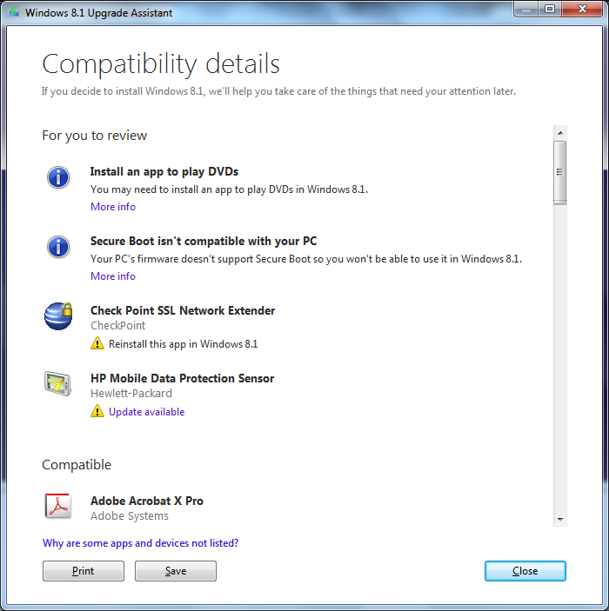
Notes:
When it comes to software, the easiest way to see if your current apps work with
Windows 8.1 is to visit the Windows Compatibility Center at:
http://www.microsoft.com/en-us/windows/compatibility/CompatCenter/Home

Slide 14
Unattended Installation
/Image Deployment
An unattended installation, you don’t need to be sitting in front of the machine to complete the operation
Image deployment, copying an ideal image over from one machine to another using tools like Windows ADK or Symantec Ghost.
Notes:
Windows ADK - Windows Assessment and Deployment Kit

Slide 15
Remote Network Installation
PXE-initiated boot (Pre-Execution Environment), the workstation involved in the installation can retrieve the files from the network as opposed DVD in their drive or attached USB

Slide 16
Multiboot Installation
More than one operating system on one system
User chooses which one to run when you boot
Go to Control Panel ➢ System and Security ➢ System, and click Advanced System Settings. Under System startup choose default OS

Slide 17
Repair Installation /Refresh/Restore
Windows Recovery Environment (Windows RE)
Options
Refresh
Reset
Restore
Notes:
Refreshing it keeps personal files and settings along with the default apps and
those that you installed from the Windows Store
Resetting reinstalls Windows and deletes all but the default apps (meaning that you lose
your personal files and settings)
Restoring allows you to just undo recent system changes

Slide 18
Recovery Partition
An area of the hard drive set aside to hold files that can be used to recover the operating system in the event of a failure
You can copy the information from this partition to another location (usually a USB drive) to use in the event that the partition fails
EXERCISE 15.1: CREAT ING A USB RECOVERY DRIVE

Slide 19
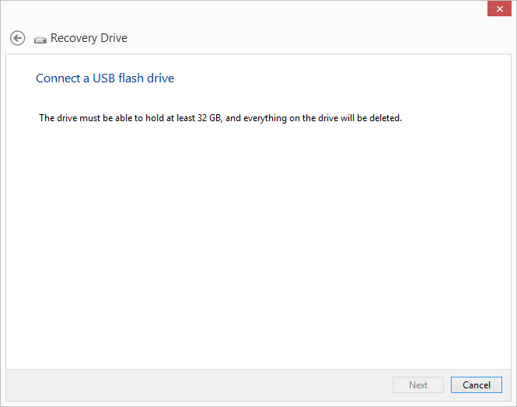
Recovery Drives

Slide 20
Windows 8 Boot Methods
Internal Hard Drive
External/Hot Swappable Drive
Flash Drive
Solid State Drive
Netboot
Notes:
A hard drive can be divided into multiple partitions, and it is not uncommon to have
one for the system and one for data or recovery.
System partition is one that contains the Boot (BCD) folder that tells the computer where to look to start Windows
Boot partition (which can be the same as the system partition) contains the actual
files used to start Windows,
Recovery partition includes recovery tools (like Windows RE tools or a recovery image).

Slide 21
Key Boot Files
BOOTMGR
BCD
WINLOAD.EXE
NTOSKRNL.EXE
WINRESUME.EXE
System files
  HAL.DLL
  SMSS.EXE
  WINLOGON.EXE
  LSASS.EXE
Notes:
BOOTMGR – Starts the loading of an OS (bootstraps the system)
BCD (Boot Configuration Data) - holds information about OSs installed on the computer, such as the location of the OS files
WINLOAD.EXE Loads the operating system kernel (NTOSKRNL.EXE).
WINRESUME.EXE If the system is not starting fresh but resuming a previous session, then WINRESUME.EXE is called by the BOOTMGR.
NTOSKRNL.EXE The Windows OS kernel
System Files (Reside in the system Directory)
For example
hardware abstractionlayer (HAL.DLL),
session manager (SMSS.EXE),
user session (WINLOGON.EXE), and
security subsystem(LSASS.EXE)

Slide 22
Windows To Go
Windows To Go - allow Windows 8/8.1 to be installed on any USB-bootable device: flash drive, external hard drive, and so forth
An image of the OS is known as a workspace, and you can use BitLocker with WTG to secure the workspace

Slide 23
NetBoot
The process of booting the OS from the network
This can be done with Windows 8 using Microsoft Desktop Virtualization
useful option for environments where hardware is kept to a minimum

